Slide 1
Office 365 Development

Slide 2

Agenda
Intro
Extend with Add-ins
Connect with Office 365 APIs
Open Platform
Distribution
Resources

Slide 3

"The most strategic developer surface area for us is Office 365“ - Satya Nadella
Notes:
Why?
The key to enterprise productivity going forward
Microsoft’s strategic advantage in the Enterprise
Partners and Developers are key to its success

Slide 4
Opportunity
850 million meetings are created a month
Over 4 trillion emails sent with O365
100+ million downloads of mobile apps
2–3 hours/day spent in Office apps
1.2 billion+ users
470+ PB of storage
Notes:
BUT WHY SHOULD YOU CARE ABOUT OFFICE DEVELOPMENT???
BECAUSE THE OPPORTUNITY IS HUGE
Keypoints
NUMEROUS people use Office (1.2B) and spend significant time in Office (2-3 hours daily)
Office 365 has collected a staggering amount of data/insights about how/what people work on (470+ PB)
We want developers exploit both of these advantages by extending the Office experience that is so popular and tap into the valuable data collected in Office 365
Let’s start by looking at how we are enabling developers to extend the Office experience

Slide 5















Vision
EXTEND OFFICE EVERYWHERE
CONNECT TO OFFICE 365 SERVICES
BUILD USING AN OPEN PLATFORM
Delve
z
Users and groups
Files
Mail
Calendar
My Apps
Video Portal
Contacts
Office Graph
Presentations
Documents
Spreadsheets
Lync
OneNote
Yammer

Slide 6
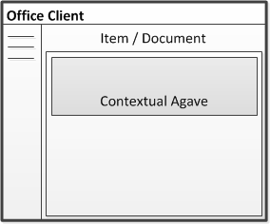
Extend
Office 365
OFFICE & SHAREPOINT ADD-INS

Slide 7
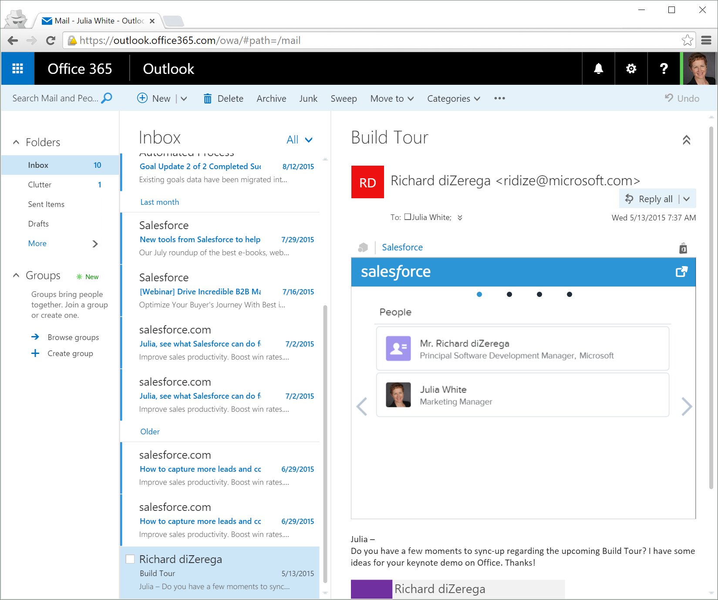
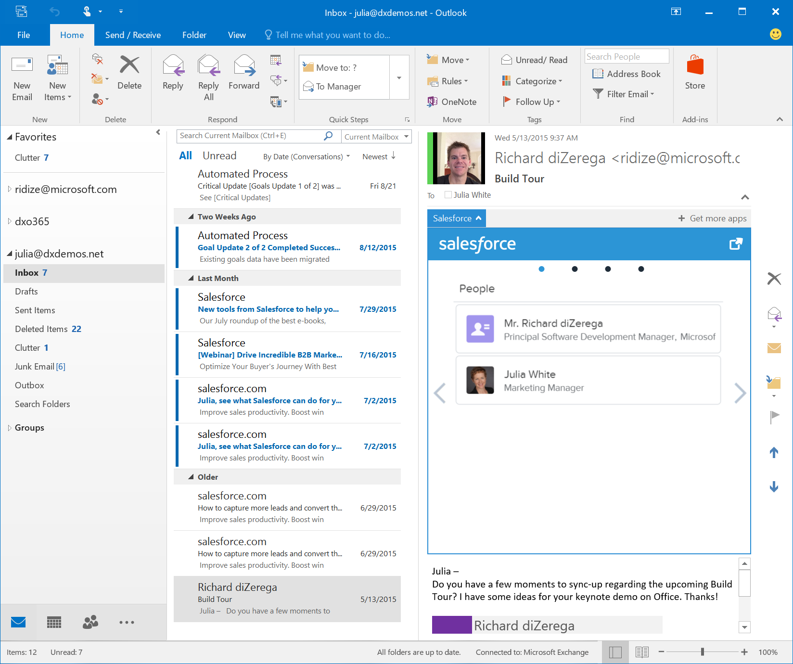
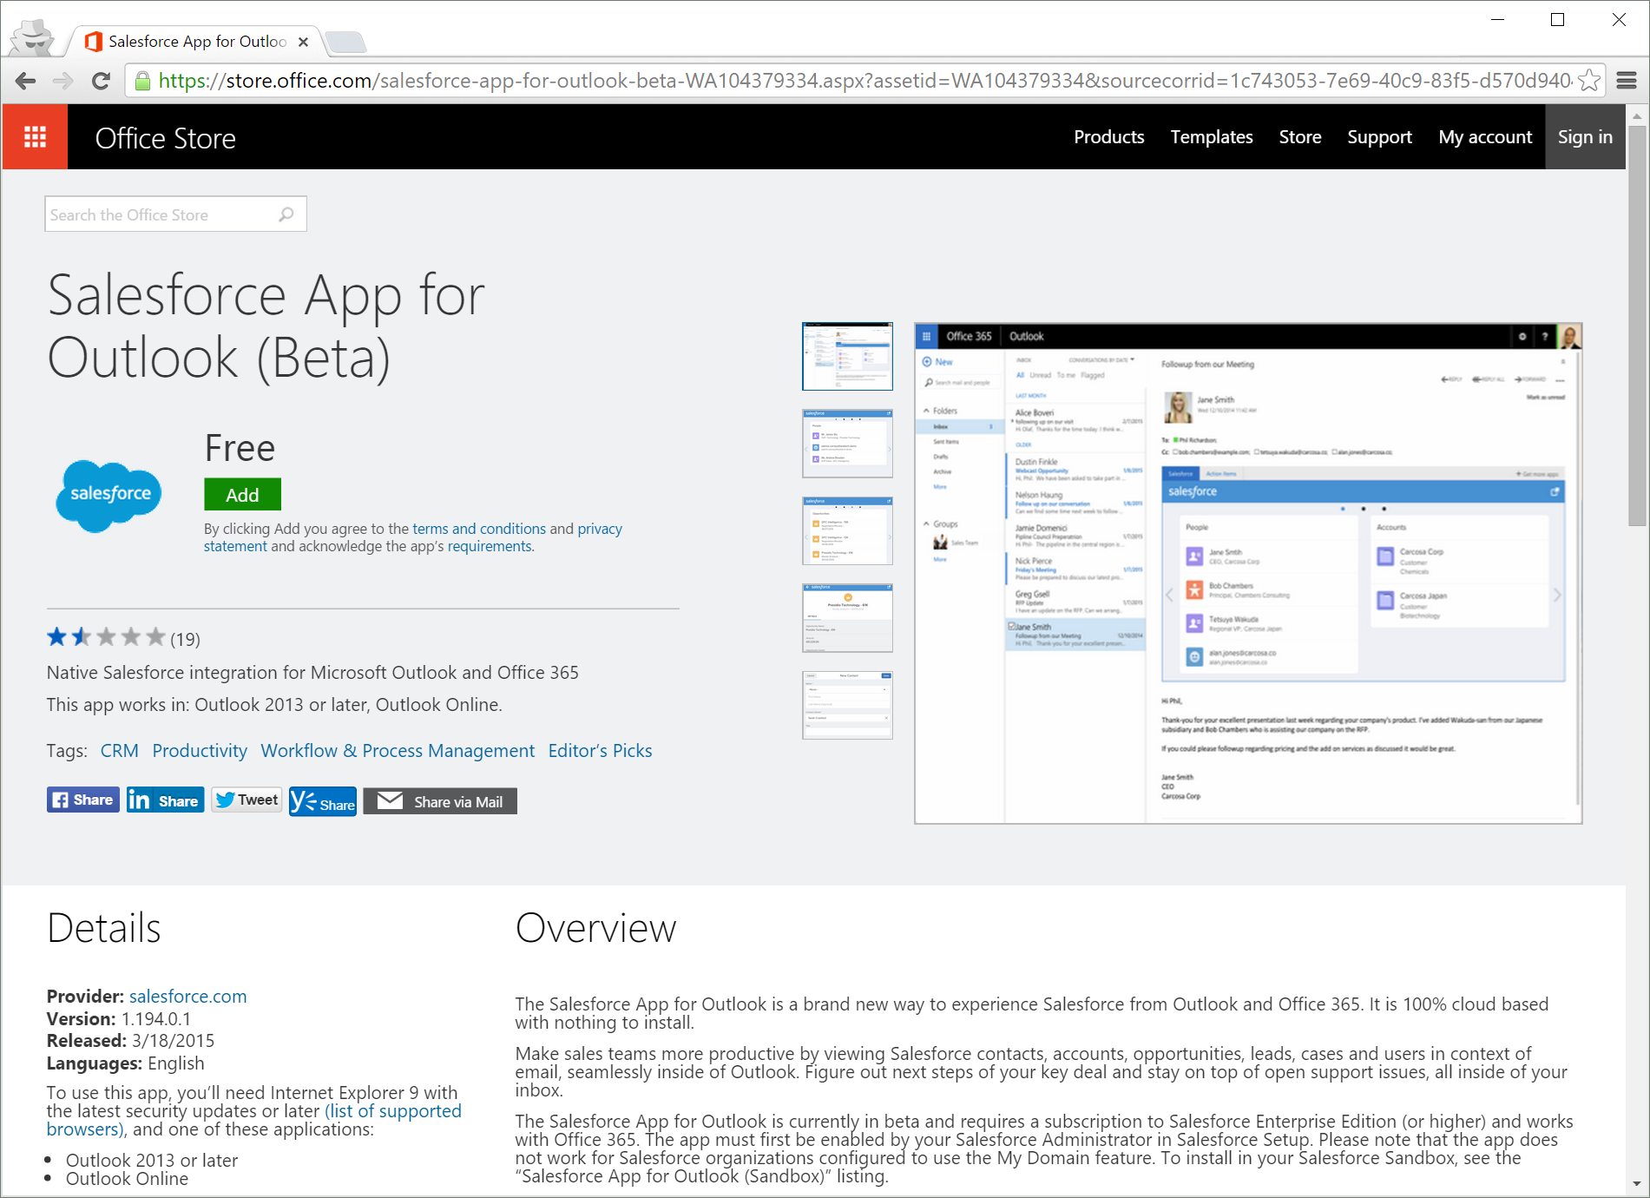
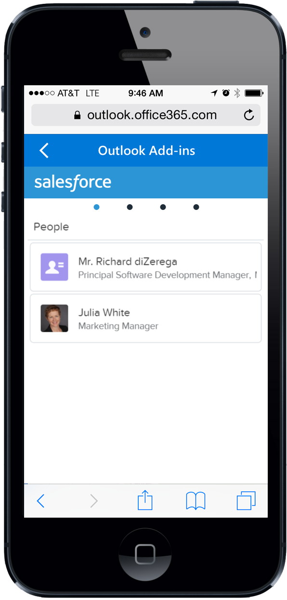
Office Add-ins
Built with web standards
Office.js provides interop
Hosted centrally
Almost zero client footprint
Runs where Office runs
Discoverable marketplace
<?xml version="1.0" encoding="UTF-8"?>
<OfficeApp xsi:type="MailApp">
<Version>1.0.0.0</Version>
<ProviderName>Salesforce.com</ProviderName>
<DefaultLocale>en-US</DefaultLocale>
<DisplayName DefaultValue=“Salesforce" />
<Capabilities>
<Capability Name="Mailbox" />
</Capabilities>
<DesktopSettings>
<SourceLocation DefaultValue=“https://salesforce.com/office" />
<RequestedHeight>300</RequestedHeight>
</DesktopSettings>
<Permissions>ReadItem</Permissions>
<Rule xsi:type="RuleCollection" Mode="Or">
<Rule xsi:type="ItemIs" ItemType="Message"/>
<Rule xsi:type="ItemIs" ItemType="Appointment"/>
</Rule>
</OfficeApp>
Office.js
Browser Control
or iFrame
With HTML5,
JavaScript, CSS
Web Server

Slide 8
Office Add-ins A new way to build extensions for Office
Contextual Mail Add-in
Add-in launched contextually from a mail message or appointment
Outlook and Outlook Web Access (OWA)
Task Pane Add-in
Add-in that runs beside a document/mail with read/write access
Word, Excel, PowerPoint, Project, Outlook
Content Add-in
Add-in that runs within a document content with read/write access
Excel, PowerPoint, Access
Add-in Command
Command in the Office UI to launch add-in or perform UI-less operation
Outlook, Outlook Web Access (OWA)

Slide 9
Demo
Notes:
PPTX - Poll Everywhere
Excel – People Graph
Word - Docusign
Outlook - Maps and Boomerang

Slide 10
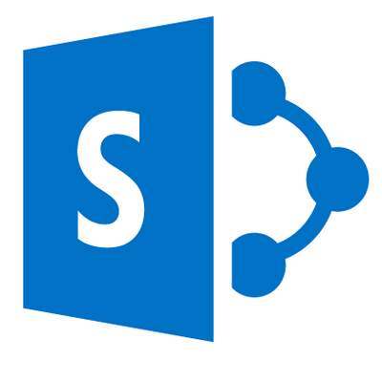

SharePoint Add-ins
Logic decoupled from SharePoint
Communicates with SharePoint via rich APIs (REST or CSOM)
Built and hosted with any web platform
Granular permission model powered by OAuth
REST/CSOM
Read Web
Write User Profiles
Read Managed Metadata

Slide 11
SharePoint Add-ins A new way to build extensions for SharePoint
Full Page Add-ins
Implement complete app experiences to satisfy business scenarios
Add-in Parts
Create web parts that can interact with the SharePoint experience
Add-in Commands
Add new commands to the ribbon and contextual menus
SharePoint Dialog
Create contextual dialog from ribbon commands and item menus

Slide 12
Demo
Notes:
Demo Tiny Links (uses full-page, add-command, and dialog)

Slide 13

Connect to Office 365 services

Slide 14
Robust Office 365 APIs
Designed for openness and flexibility
Enabling a consistent development platform
Powering a world of devices
https://graph.microsoft.com
Documents
Mail
Calendar
People
Search
Office Graph
Groups
Notebooks
Videos
Social
iOS
dev.office.com
Notes:
Discuss the Office 365 APIs and their ability to provide connectivity into key O365 services (mail, calendar, files, notes, etc) from stand alone applications

Slide 15
Azure Active Directory
microsoft.onmicrosoft.com
contosotravel.onmicrosoft.com
yourcompany.onmicrosoft.com
app
app
app
Exchange Online
SharePoint Online
OneNote
Yammer
Travel Pro
Expense Manager
Some App
Another App
Microsoft Travel
Notes:
Explain how each O365 customer gets a domain in Azure AD…this is consider the “tenant”
Explain how this domain in Azure AD contains users, groups, and APPS
Organizations can host private (single-tenant) apps and public (multi-tenant) apps
Apps can have permissions to talk to other apps

Slide 16
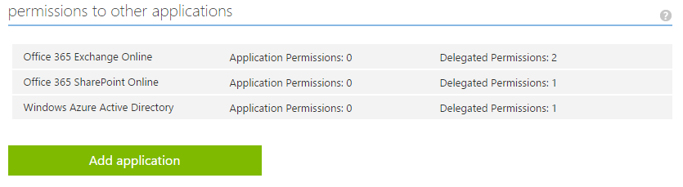
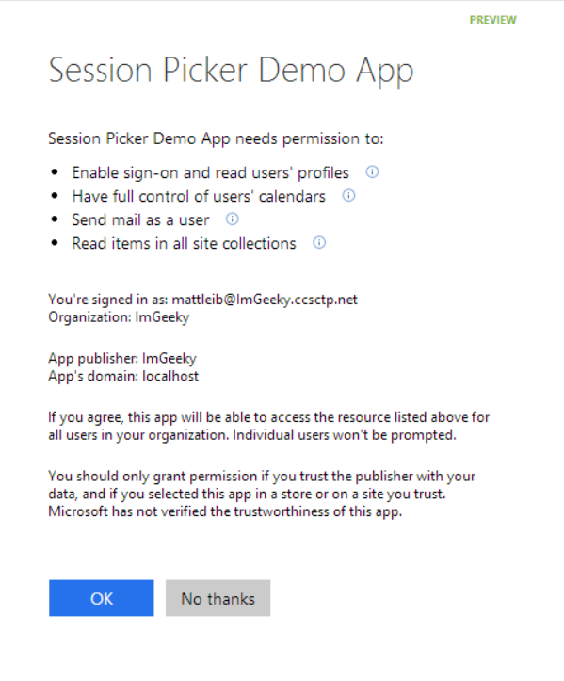
Azure AD Applications
Notes:
This shows the permission configuration screen for an Azure AD application and what the user sees when they are asked for

Slide 17
Demo
Notes:
Do.com
Docusign

Slide 18




Open Platform
ADAL Library | ✔ | ✔ | ✔ | ✔ |  |  | ✔ | ✔ | ✔ | ✔ | ✔ | ✔ | ✔
Office 365 SDK | ✔ |  |  |  |  |  |  | ✔ | ✔ | ✔ | ✔ | ✔ | ✔
Dev.office.com Samples | ✔ | ✔ | ✔ | ✔ | ✔ | ✔ | ✔ | ✔ | ✔ | ✔ | ✔ | ✔ | ✔
z
Azure AD and Office 365 offer Libraries/SDKs, but they are not mandatory as the platform is building on web standards such as OAuth2, REST, and OData
Notes:
Yes, this is a busy slide, but the main points are:
We have SDKs (ADAL and O365 for most major platforms)
You don’t need SDKs to leverage Office 365 APIs given they follow standards like Oauth and REST
We offer a Yeoman Generator for building add-ins outside of Visual Studio

Slide 19


Distribution choices
Office Store
Add-in Catalog
Notes:
Lifecycle
Not just the store
Momuntem has been building store and on-prem
Store features ; subscriptions
Business-ready
Corporate catalog
Training users to get new experiences

Slide 20
Corporate Add-in Catalog
Secure access to internal apps
Centrally managed repository of private apps
Direct deployment to employees

Slide 21
Resources
Office 365 Development Overview

Slide 22
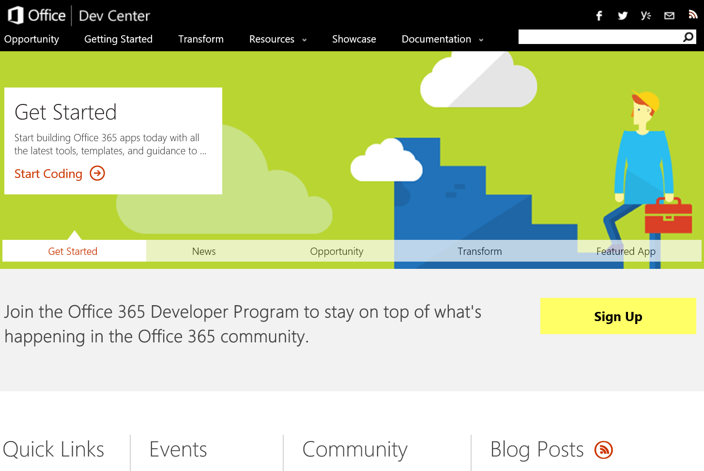
http://dev.office.com
dev.Office.com
Opportunity
Getting Started
Transform
Resources
Showcase
Documentation

Slide 23
Virtual Academy Courses
Office 365 Development
Course 1: Introduction to Office 365 Development
Course 2: Deep dive into the Office 365 App Model
Course 3: Deep Dive into integrating Office 365 APIs with your standalone web application development
Course 4: Deep Dive into integrating Office 365 APIs with your mobile device development
Course 5: Shipping your Office 365 App to the Office Store
Course 6: Deep dive into the building blocks and services of the SharePoint platform
Course 7: Deep Dive into Office 365 Development on non-Microsoft Stack
http://www.microsoftvirtualacademy.com/product-training/office-development

Slide 24
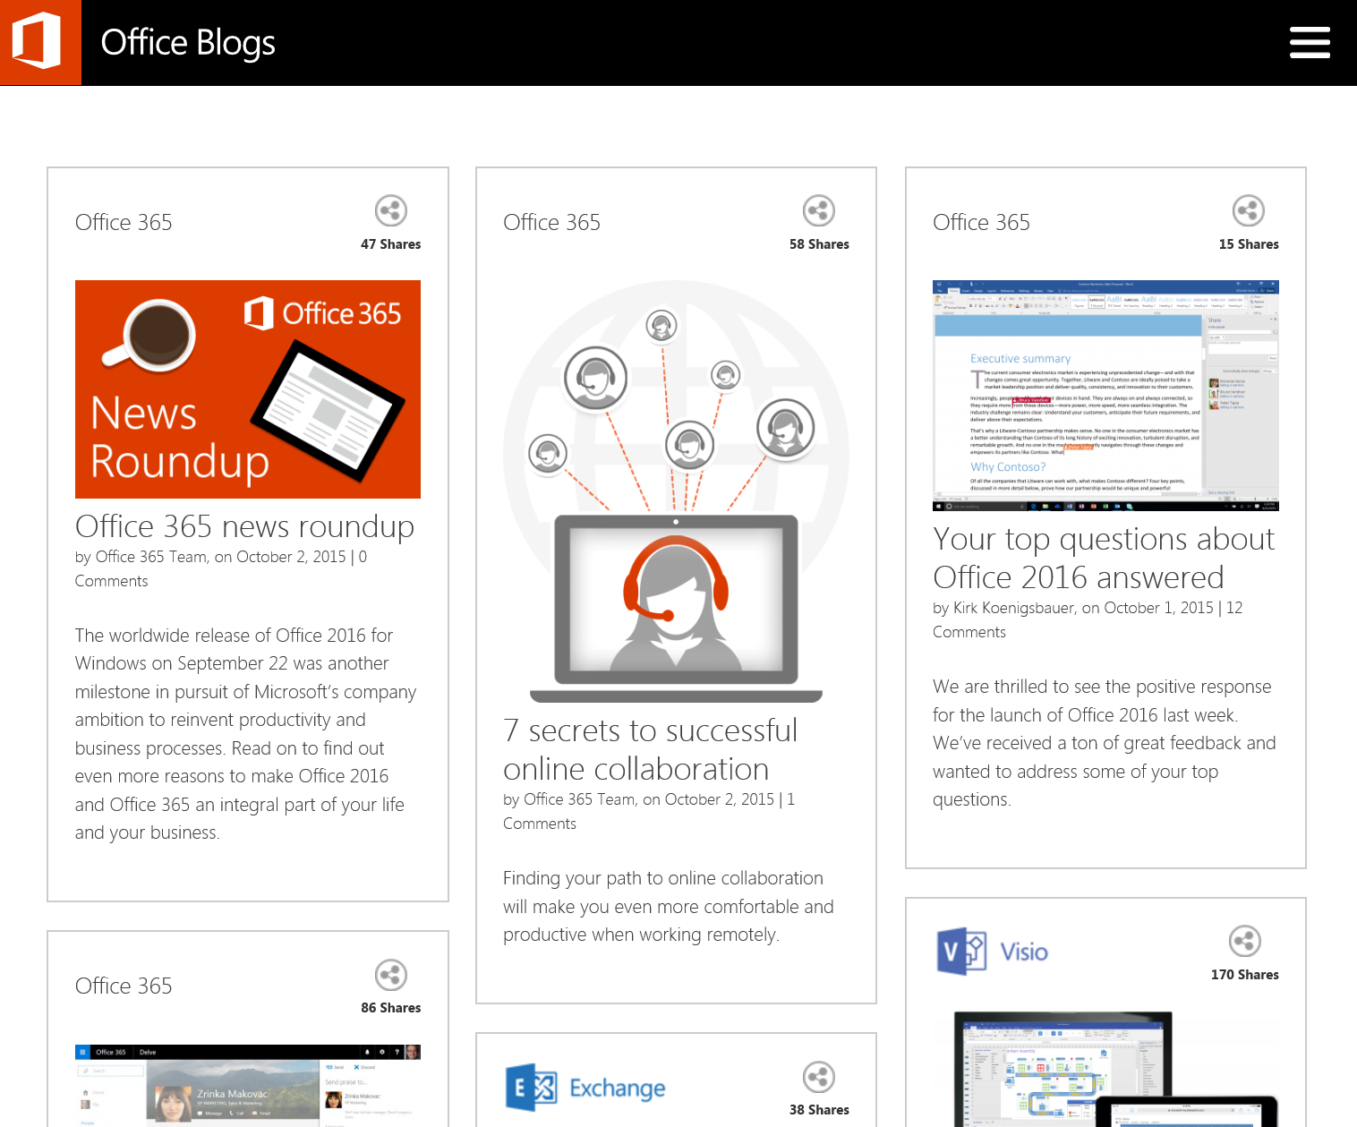
http://blogs.office.com
Office 365 news
Dev announcements
Events
Garage Series videos
Weekly podcast

Slide 25
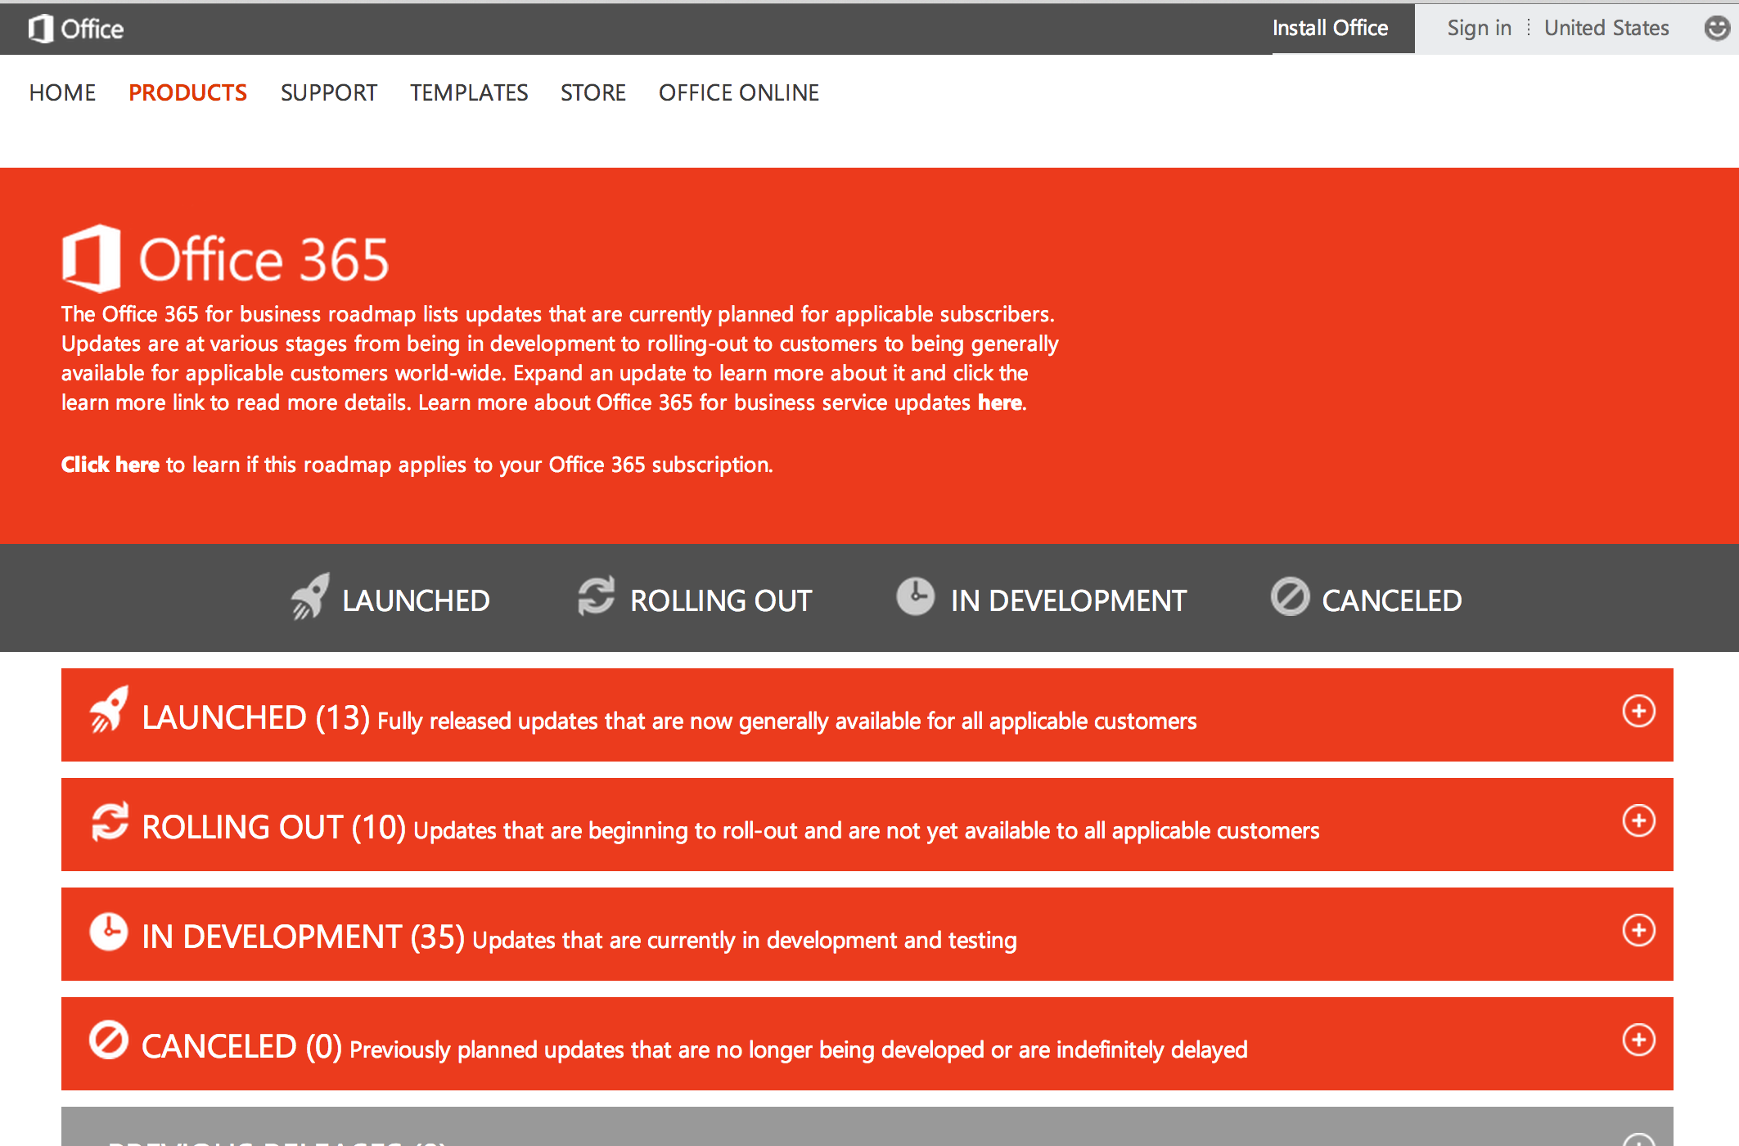
http://www.office.com/roadmap
Monthly updates
Developer features
Associated blog posts

Slide 26


Engage
Office 365 Network Share you best practices and join conversations https://www.yammer.com/itpronetwork Stackoverflow Ask deep technical questions to a world-wide set of developers http://aka.ms/stackoffice UserVoice Provide suggestions of what you want in future versions http://officespdev.uservoice.com/
Twitter Follow our tweets announcing news and relevant dev content http://www.twitter.com/OfficeDev Podcast Follow our tweets announcing news and relevant dev content http://dev.office.com/podcasts Office Dev Show (CH9) Watch the latest new and developer tips from Office Engineers http://aka.ms/OfficeDevShow

Slide 27


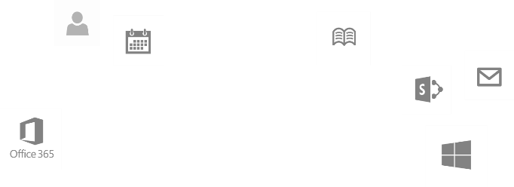
dev.office.com
Sign up
http://dev.office.com/getting-started
Explore
http://api.microsoft.com
Get trained http://dev.office.com/training

